Slide 1
Lecture 2.2 Mixed strategies

Slide 2
Mixed Strategy Equilibria
To this point considered pure strategy equilibria.
Sometimes randomization can be best strategy. Consider the following game:
 |  |  | Bob
 |  | Rock | Paper | Scissors
 | Rock | 0,0 | -1,1 | 1,-1
Bill | Paper | 1,-1 | 0,0 | -1,1
 | Scissors | -1,1 | 1,-1 | 0,0

Slide 3
Pure versus mixed strategy nash equilibrium
Rock-Paper-Scissors has no “pure” strategy (non random) Nash equilibrium.
It has a mixed/random-strategy Nash equilibrium: each player chooses actions randomly (i.e. choose each action with probability 1/3).
Similar outcomes in:
games where each player would like to “out guess” the other
“zero-sum” games where payoffs are negatively correlated (i.e. I must be doing worse when you are doing better).

Slide 4
Pure versus mixed strategy nash equilibrium
In a mixed strategy Nash equilibrium:
players randomise over pure strategies
as in a pure strategy Nash equilibrium, no one has an incentive to change strategy
logically, this means that every pure strategy a player randomises over must be equally profitable.

Slide 5
Mixed Strategy Equilibria
Think about a decision about whether to commit to a negative or positive advertising campaign.
There is no dominant strategy and no Nash equilibrium in pure strategies. We have a zero-sum game: if Boeing gains $10, Airbus loses $10, and vice versa.
 |  | Airbus
 |  | Negative | Positive
Boeing | Negative | $10, -$10 | -$10, $10
 | Positive | -$10, $10 | $10, -$10

Slide 6
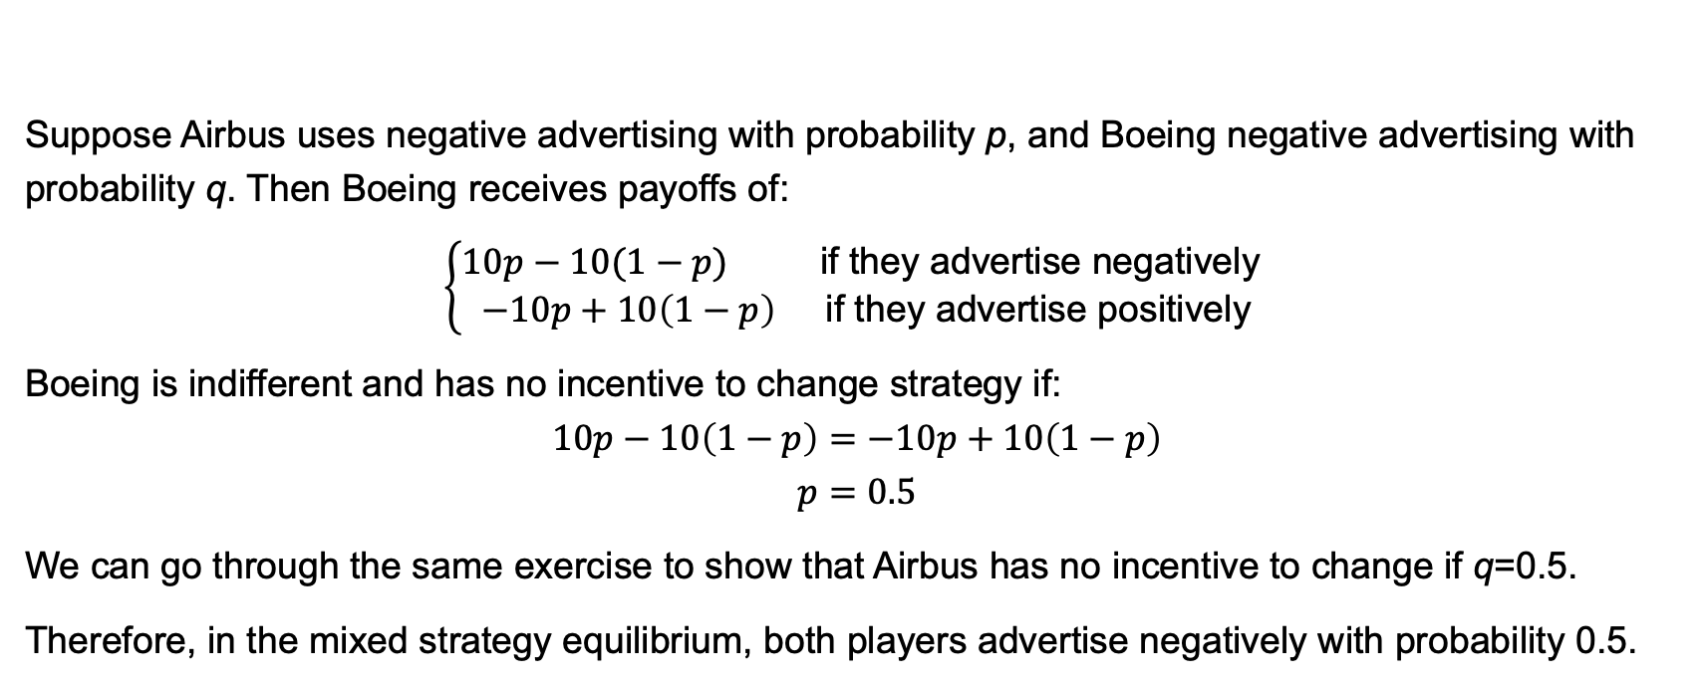
Mixed Strategy Equilibria
Suppose Airbus uses negative advertising with probability p, and Boeing negative advertising with probability q. Then Boeing receives payoffs of:
$$\left\{\begin{aligned}10p−10(1−p) \text{if} \text{they} \text{advertise} \text{negatively} \\ −10p+10\left(1−p\right) \text{if} \text{they} \text{advertise} \text{positively}\end{aligned}\right.$$
Boeing is indifferent and has no incentive to change strategy if:
$$10p−10\left(1−p\right)=−10p+10\left(1−p\right)$$
$$p=0.5$$
We can go through the same exercise to show that Airbus has no incentive to change if q=0.5.
Therefore, in the mixed strategy equilibrium, both players advertise negatively with probability 0.5.

Slide 7
Mixed Strategy Equilibria
Let’s think about Boeings choice in a different way.
The only way they can achieve a payoff that is independent of Airbus’s action is to randomise with probability q=0.50. Consider if Airbus chooses a positive campaign with probability p:
0.5p becomes the probability that Boeing matches Airbus’s positive campaign.
0.5(1-p) becomes the probability that Boeing matches Airbus’s negative.
Probability of Boeing winning equals 0.5p + 0.5(1-p) = 0.5.
Probability of Boeing losing equals 0.5p + 0.5(1-p) = 0.5.
Therefore Boeing’s payoff is independent of what Airbus does.

Slide 8
Example: Pricing
Consider a town with:
two stores each with 1,000 loyal customers (who always shop there)
an additional 1,000 shoppers who go where prices are lowest.
Think of these as informed and uninformed customers.
Shoppers are willing to pay up to $2 for paper towels for which the marginal cost is $1.
The two stores simultaneously choose a price (between $1 and $2)
What should the firms do?
Let’s look for a Nash equilibrium to this game.

Slide 9
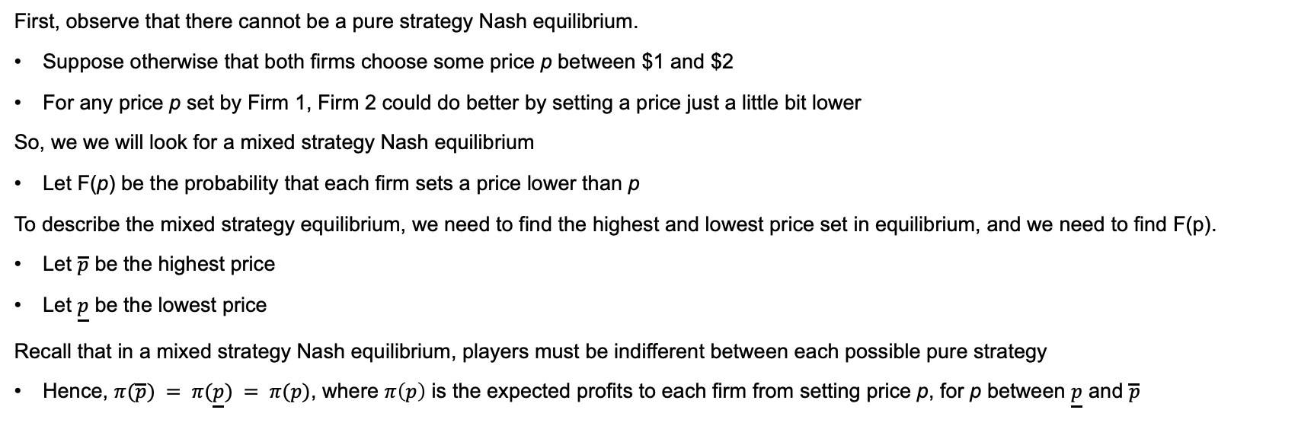
Example: Pricing
First, observe that there cannot be a pure strategy Nash equilibrium.
Suppose otherwise that both firms choose some price p between $1 and $2
For any price p set by Firm 1, Firm 2 could do better by setting a price just a little bit lower
So, we we will look for a mixed strategy Nash equilibrium
Let F(p) be the probability that each firm sets a price lower than p
To describe the mixed strategy equilibrium, we need to find the highest and lowest price set in equilibrium, and we need to find F(p).
Let $\overline{p}$ be the highest price
Let $\underline{p}$ be the lowest price
Recall that in a mixed strategy Nash equilibrium, players must be indifferent between each possible pure strategy
Hence, $π(\overline{p}) = π(\underline{p}) = π(p)$, where $π\left(p\right)$ is the expected profits to each firm from setting price p, for p between $\underline{p}$ and $\overline{p}$

Slide 10
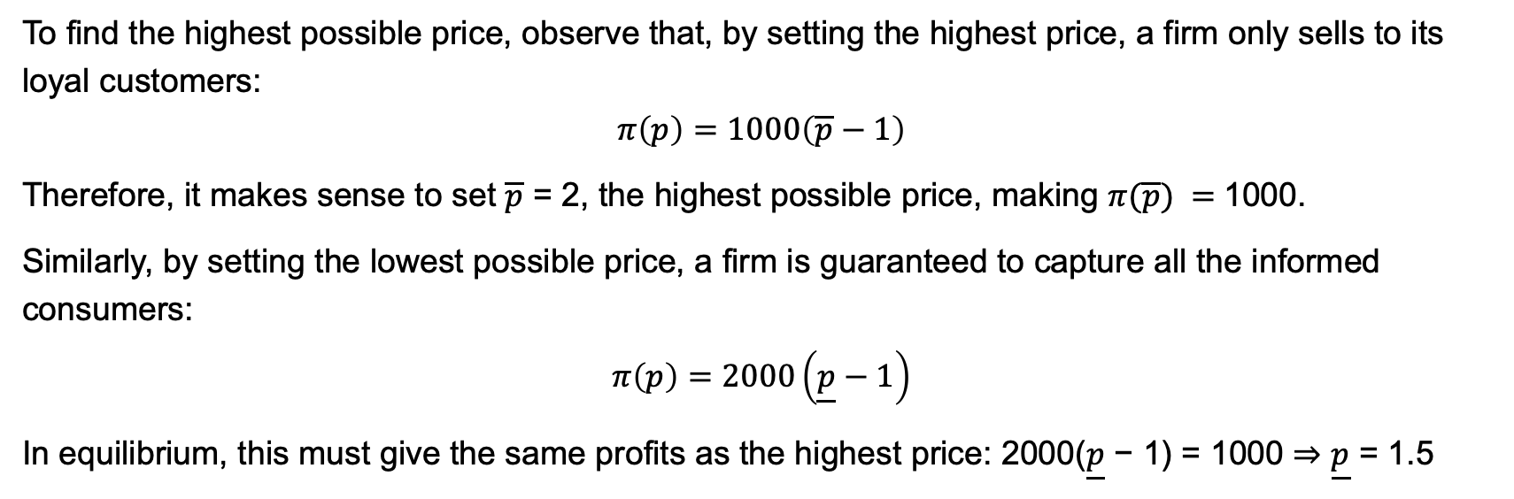
Example: Pricing
To find the highest possible price, observe that, by setting the highest price, a firm only sells to its loyal customers:
$$π\left(p\right)=1000\left(\overline{p}−1\right)$$
Therefore, it makes sense to set $\overline{p}$ = 2, the highest possible price, making $π(\overline{p}) =$1000.
Similarly, by setting the lowest possible price, a firm is guaranteed to capture all the informed consumers:
$$π\left(p\right)=2000\left(\underline{p}−1\right)$$ In equilibrium, this must give the same profits as the highest price: 2000($\underline{p}$ − 1) = 1000 ⇒ $\underline{p}$ = 1.5

Slide 11
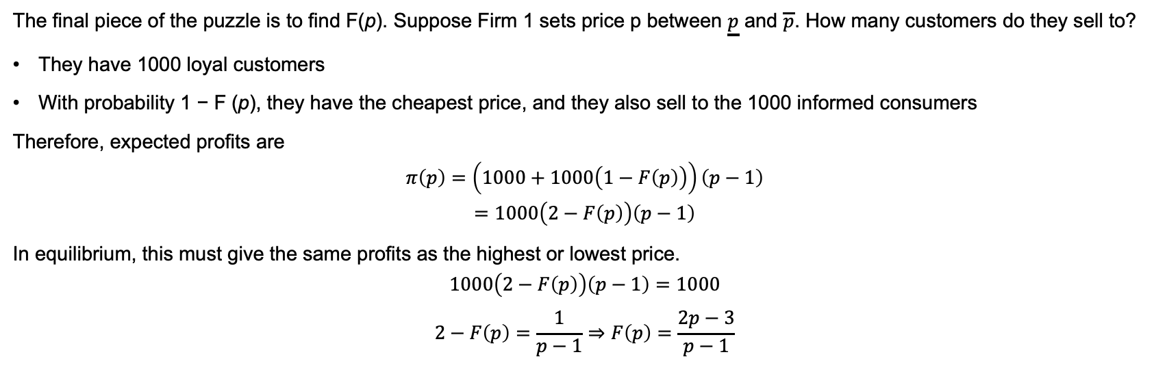
Example: Pricing
The final piece of the puzzle is to find F(p). Suppose Firm 1 sets price p between $\underline{p}$ and $\overline{p}$. How many customers do they sell to?
They have 1000 loyal customers
With probability 1 − F (p), they have the cheapest price, and they also sell to the 1000 informed consumers
Therefore, expected profits are
$$π\left(p\right)=\left(1000+1000\left(1−F\left(p\right)\right)\right)\left(p−1\right)$$
$$=1000\left(2−F\left(p\right)\right)\left(p−1\right)$$
In equilibrium, this must give the same profits as the highest or lowest price.
$$1000\left(2−F\left(p\right)\right)\left(p−1\right)=1000$$
$$2−F\left(p\right)=\frac{1}{p−1}⇒F\left(p\right)=\frac{2p−3}{p−1}$$

Slide 12
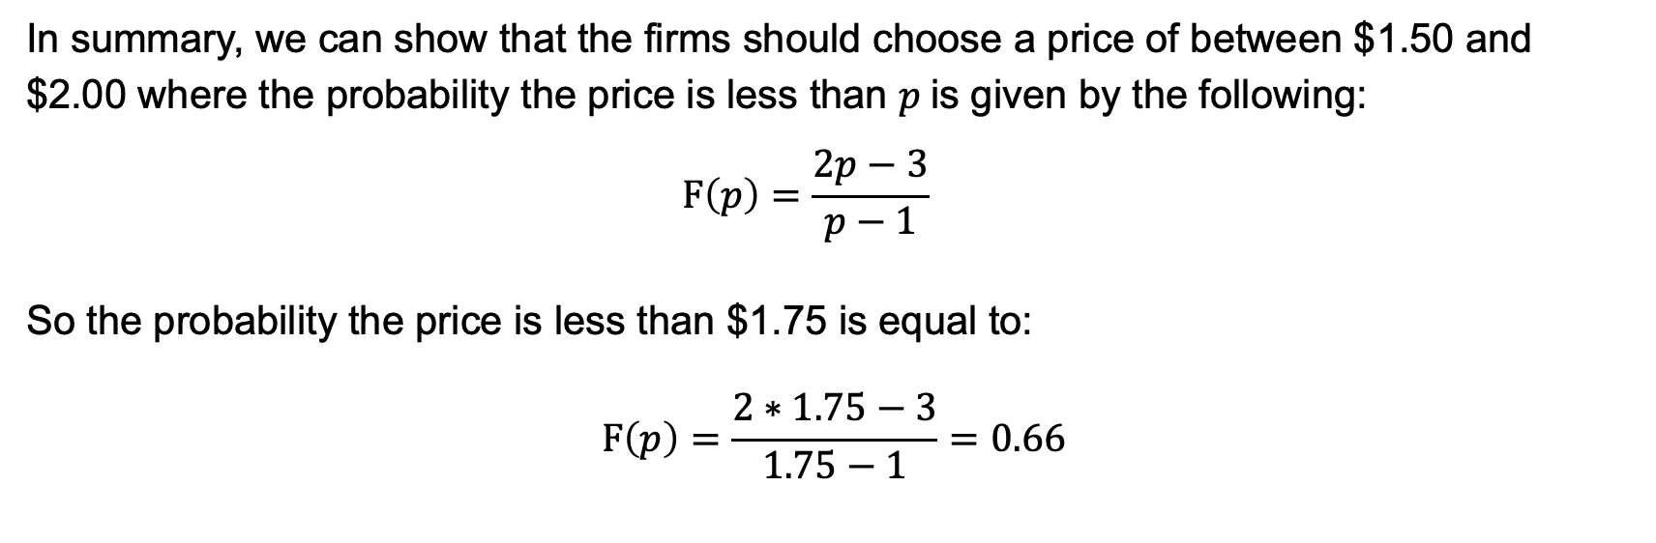
Example: Pricing
In summary, we can show that the firms should choose a price of between $1.50 and $2.00 where the probability the price is less than $p$is given by the following:
$$F\left(p\right)=\frac{2p−3}{p−1}$$
So the probability the price is less than $1.75 is equal to:
$$F\left(p\right)=\frac{2∗1.75−3}{1.75−1}=0.66$$

Slide 13
Example: Pricing
So what is the intuition and lesson here?
We are thinking about a game where the firms are randomly choosing a price – in effect randomly choosing to have a sale. They might have a sale one week in every three and so set the price less than $1.75 once every three weeks.
The question is whether this is the best strategy and what does it mean for the other firm – will they respond and how to do they respond?
What we showed was the equilibrium set of strategies.

Slide 14
Example: Market Entry
Consider the market entry game in which firms try to decide whether to enter a market.
 |  | Pure Water Co
 |  | Enter | Don’t enter
Eau Claire | Enter | -$50, -$50 | $100, $0
 | Don’t enter | $0, $100 | $0, $0

Slide 15
Example: Market Entry
There are two pure strategy equilibria. But is there a mixed strategy equilibrium?
 |  | Pure Water Co
 |  | Enter | Don’t enter
Eau Claire | Enter | -$50, -$50 | $100, $0
 | Don’t enter | $0, $100 | $0, $0

Slide 16
Example: Market Entry
The key to solving this is to note that:
“Every pure strategy that is played as part of a mixed strategy Nash equilibrium has the same expected value”
Let p be probability that Eau Claire enters, and 1-p be probability that Eau Claire does not enter.
Let q be probability that Pure Water Co enters, and 1-q be probability that Pure Water Co does not enter.
Eau Claire’s profit if it chooses the pure strategy of entering while Pure Water Co uses a mixed strategy:
EV₁(enter) = -50q + (1-q)100
Suppose Eau Claire chooses the pure strategy of not entering while 2 uses a mixed strategy. This gives a payoff of 0.

Slide 17
Example: Market Entry
Now, we want to set the payoffs for Eau Claire under both pure strategies equal to each other:
EV₁(enter) = EV₁(stay out) , or
-50q + (1-q)100 =0
q=2/3
Note Eau Claire’s expected payoff:
EV₁(enter) = 2/3*(-50)+1/3*(100) = EV₁(stay out) = 0
So applying the same approach to Pure Water Co, the equilibrium strategy is 2/3 probability on entering market.

Slide 18
Example: Market NICHE
Consider the market niche game in which firms try to carve out a market niche. Note that this is no longer symmetric.
Again, two pure strategy equilibria.
 |  | Pure Water Co
 |  | Enter | Don’t enter
Eau Claire | Enter | -$50, -$50 | $150, $0
 | Don’t enter | $0, $100 | $0, $0

Slide 19
Example: Market NICHE
Solving again:
Let p be probability that Eau Claire enters, and 1-p be probability that Eau Claire does not enter.
Let q be probability that Pure Water Co enters, and 1-q be probability that Pure Water Co does not enter.
Eau Claire’s profit if it chooses the pure strategy of entering while Pure Water Co uses a mixed strategy:
EV₁(enter) = -50q + (1-q)150
Suppose Eau Claire chooses the pure strategy of not entering while Pure Water Co uses a mixed strategy. This gives a payoff of 0.

Slide 20
Example: Market NICHE
Now, we want to set the payoffs for Eau Claire under both pure strategies equal:
EV₁(enter) = EV₁(stay out) , or
-50q + (1-q)150 =0
q=3/4
Note Eau Claire’s expected payoff:
EV₁(enter) = 3/4*(-50)+1/4*(100) = EV₁(stay out) = 0
Applying the same approach to Pure Water Co, the equilibrium strategy for Eau Claire is 2/3 probability on entering market (as for the first case).

Slide 21
EXAMPLE: SALES
Think about a choice between everyday low pricing versus sales. There are two pure strategy equilibria.
 |  | Big W
 |  | No sale | Sale
Target | No sale | $7500, $7500 | $7500, $8500
 | Sale | $8500, $7500 | $5500, $5500

Slide 22
EXAMPLE: SALES
What of a mixed strategy?
Let p be probability Target charges normal price and 1-p be probability charging sale price.
Let q be probability Big W charges normal price and 1-q be probability charging sale price.
Target’s profit if it chooses the pure strategy of charging a sale price while Big W uses a mixed strategy:
EV (SP) = 8500q + 5500(1-q)
Suppose Target chooses the pure strategy of normal pricing while Big W uses a mixed strategy. This gives a payoff of $7500.

Slide 23
EXAMPLE: SALES
We want to set the payoffs for Target under both pure strategies equal :
EV (NP) = EV (SP) = 7500, or
8500q+ 5500(1-q)=7500
Solving: q=2/3
Note Target’s expected payoff:
EV (SP) = 1/3*(5500)+2/3*(8500) = EV₁(NP) = 7500
Applying the same approach to Big W, the equilibrium strategy for Target is 1/3 probability of having a sale.

Slide 24
EXAMPLE: SALES
We an also approach this using best response curves:
 |  | Big W
 |  | No sale | Sale
Target | No sale | $7500, $7500 | $7500, $8500
 | Sale | $8500, $7500 | $5500, $5500

Slide 25
EXAMPLE: SALES
Let p be probability that Target plays no sale, and 1-p be probability it plays sale
Let q be probability that BigW plays no sale, and 1-q be probability it plays sale.
Combination | Probability | Payoff to Target
No sale, no sale | pq | 7500
Sale, no sale | (1-p)q | 8500
No sale, Sale | p(1-q) | 7500
Sale, Sale | (1-p)(1-q) | 5500

Slide 26
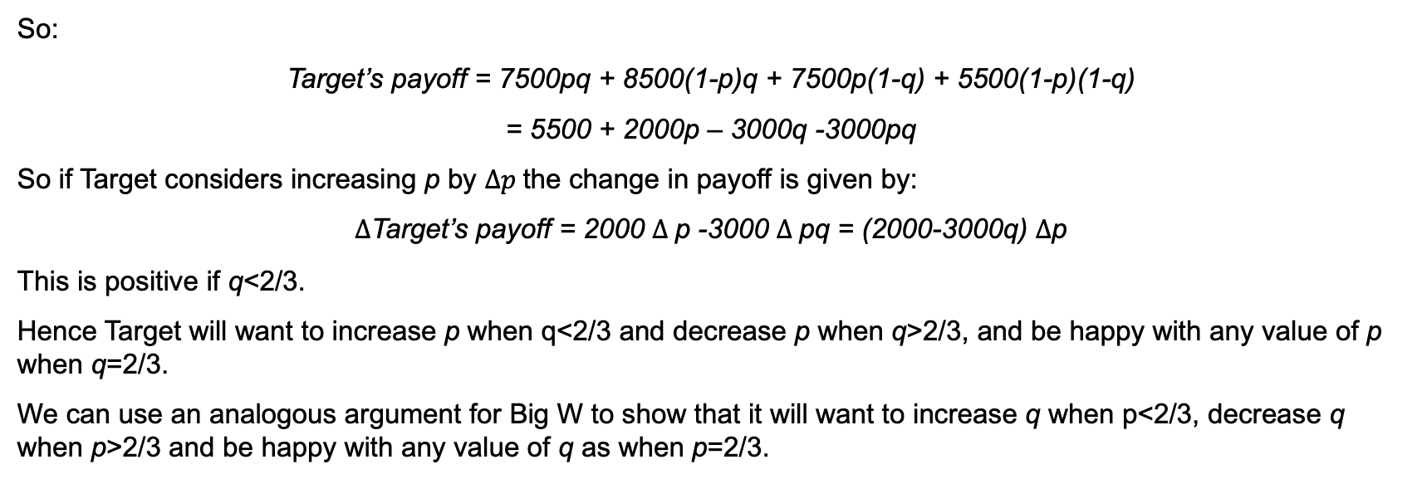
EXAMPLE: SALES
So:
Target’s payoff = 7500pq + 8500(1-p)q + 7500p(1-q) + 5500(1-p)(1-q)
= 5500 + 2000p – 3000q -3000pq
So if Target considers increasing p by $∆p$the change in payoff is given by:
$∆$Target’s payoff = 2000 $∆$p -3000 $∆$pq = (2000-3000q) $∆$p
This is positive if q<2/3.
Hence Target will want to increase p when q<2/3 and decrease p when q>2/3, and be happy with any value of p when q=2/3.
We can use an analogous argument for Big W to show that it will want to increase q when p<2/3, decrease q when p>2/3 and be happy with any value of q as when p=2/3.

Slide 27
EXAMPLE: SALES
1
We can identify Big W’s best response curve. Recall it will want to increase q when p<2/3, decrease q when p>2/3 and be happy with any value of q as when p=2/3
2/3
We can identify Targets best response curve, recall it will want to increase p when q<2/3, decrease p when q>2/3 and be happy with any value of p when q=2/3.
q
Where the curves cross correspond to the pure strategy Nash equilibrium, and the mixed strategy Nash equilibrium.
0
p
2/3
1

Slide 28
EXAMPLE: SALES
In each case the reaction functions simply told us what the best response for each of the firms was to the choice of the other firm.
When those best response curves intersected the choices were consistent and none of the players had any incentive to unilaterally change their behavior.

